Slide 1
C++ Programming:
Problem Solving and Programming
Chapter 3
Input Output

Slide 2
iostream header file
Use iostream to extract (receive) data from keyboard and send output to the screen
iostream has two standard variables
  cin - stands for common input
  cout - stands for common output
To use cin and cout, the preprocessor directive #include <iostream> must be used

Slide 3
3.1 cin and Extraction Operator >>
Input received from keyboard
Syntax: cin>> variable1 >> variable2 ...;
e.g. cin>>payRate;
cin>>hoursWorked;
OR
cin>>payRate>>hoursWorked; // more than 1 input

Slide 4
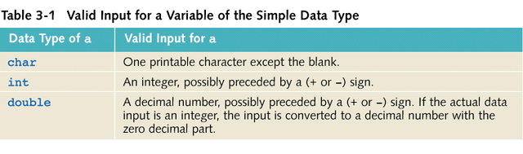
Input Data Type

Slide 5
cin and get Function
Consider the variable declarations:
char ch1, ch2;
int num;
Input : A 25
Statement : cin>>ch1>>ch2>>num;
Reads ‘A’ into ch1, ‘2’ into ch2, 5 into num
Blank space was not read

Slide 6
cin and get Function
The get function
  Inputs next character (including blank space)
The syntax of cin and the get function: cin.get(varChar);
Example:
Input : A 25
Statements: cin.get(ch1);
cin.get(ch2);
cin>>num;
=> Read ‘A’ into ch1, blank space into ch2 ,
25 into num

Slide 7
Input Failure
Things can go wrong during execution
If input data does not match the corresponding variables, the program may run into problems
Read a letter into an int or double variable
Program continue to run but result is not correct

Slide 8
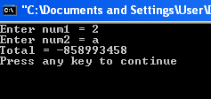
Input Failure - Example
#include <iostream>
using namespace std;
int main() {
int num1, num2, total=0;
cout<<“Enter num1 = “;
cin>>num1;
cout<<“Enter num2 = “;
cin>>num2;
total = num1 + num2;
cout<<“Total = “<<total<<endl;
return 0;
}

Slide 9
3.2 cout and insertion operator <<
Output sent to screen for display
Syntax: cout<<expression/manipulator
<<expression/ manipulator...;
Example
  cout << “I am 18!”;
  cout << “I am " << “18!";
  cout << “I am ";
  cout << “18!";
  int age = 18;
  cout << “I am “ << age << “!”;

Slide 10

The endl Manipulator
You can use the endl manipulator to start a new line of output. This will produce two lines of output:
cout << "Programming is" << endl;
cout << "fun!";
Programming is
fun!

Slide 11
The \n Escape Sequence
You can also use the \n escape sequence to start a new line of output. This will produce two lines of output:
cout << "Programming is\n";
cout << "fun!";
Programming is
fun!

Slide 12
3.3 Formatting Output by Manipulator
Two types of manipulators:
  With parameters
  Without parameters
Parameterized: use iomanip header file
  - setw(n), setprecision(n), and setfill(ch)
Nonparameterized: use iostream header file
  - endl, fixed, showpoint, left and right

Slide 13
The setw(n) Manipulator
set the width for the output using n columns
If the width / number of columns exceeds the number of columns required by the output
  Output will be right-justified
  Unused columns to the left are filled with spaces

Slide 14
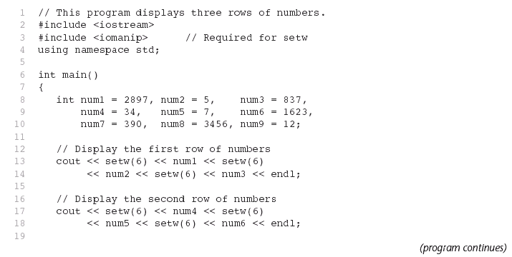
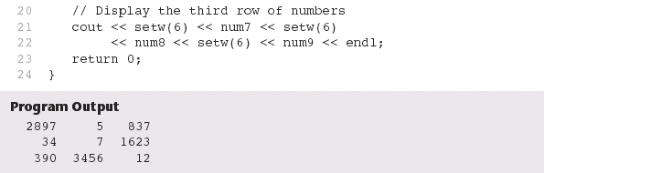
The setw(n) Manipulator - Example

Slide 15
The setfill(ch) Manipulator
Used to fill the unused columns with a character other than a space
Note: ch = character

Slide 16
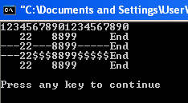
The setfill(ch) Manipulator - Example
#include <iostream>
#include <iomanip>
using namespace std;
int main( ) {
int x = 22, y = 8899;
cout << "12345678901234567890" << endl;
cout << setw(5) << x << setw(7) << y
<< setw(8) << "End" << endl;
cout << setfill('-');
cout << setw(5) << x << setw(7) << y
<< setw(8) << "End" << endl;
cout << setw(5) << x << setw(7) << setfill(‘$')
<< y << setw(8) << "End" << endl;
cout << setfill(' ');
cout << setw(5) << x << setw(7) << y
<< setw(8) << "End" << endl << endl;
return 0;
}

Slide 17
The setprecision(n) Manipulator
Display floating-point value up to n significant digits
Display floating-point value up to n decimal places when it is used with fixed manipulator
Use the following statement to disable the fixed manipulator:
cout.unsetf(ios::fixed);

Slide 18
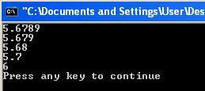
The setprecision(n) Manipulator - Example
#include <iostream>
#include <iomanip>
using namespace std;
int main( ) {
double num = 5.6789;
cout << num << endl;
cout << setprecision(4) << num << endl;
cout << setprecision(3) << num << endl;
cout << setprecision(2) << num << endl;
cout << setprecision(1) << num << endl;
return 0;

Slide 19
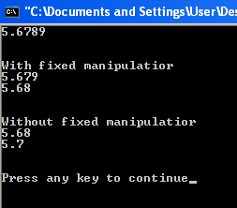
The fixed Manipulator - Example
#include <iostream>
#include <iomanip>
using namespace std;
int main( ) {
double num = 5.6789;
cout << num << endl << endl;
cout << fixed;
cout << "With fixed manipulatior" << endl;
cout << setprecision(3) << num << endl;
cout << setprecision(2) << num << endl << endl;
cout.unsetf(ios::fixed);
cout << "Without fixed manipulatior" << endl;
cout << setprecision(3) << num << endl;
cout << setprecision(2) << num << endl << endl;
return 0;
}

Slide 20

The showpoint Manipulator
Causes a decimal point and trailing zeroes to be displayed, even if there is no fractional part
Example:
#include <iostream>
#include <iomanip>
using namespace std;
int main( ) {
double x= 123.4, y = 456.0;
cout << setprecision(6) << x << endl;
cout << y << endl << endl;
return 0;
}

Slide 21

The showpoint Manipulator - Example
#include <iostream>
#include <iomanip>
using namespace std;
int main( ) {
double x= 123.4, y = 456.0;
cout << setprecision(6) << showpoint << x << endl;
cout << y << endl<< endl;
return 0;
}

Slide 22
The left & right Manipulator
Output is right justified by default
cout<<left;
  to left justify the output
  disable left by using - cout.unsetf(ios::left);
cout<<right;
  to right justify the output

Slide 23
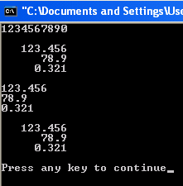
The left & right Manipulator - Example
#include <iostream>
#include <iomanip>
using namespace std;
int main( ) {
double x = 123.456, y = 78.9, z = 0.321;
cout << "1234567890" << endl << endl;
cout << setw(10) << x << endl;
cout << setw(10) << y << endl;
cout << setw(10) << z << endl;
cout << left << endl;
cout << setw(10) << x << endl;
cout << setw(10) << y << endl;
cout << setw(10) << z << endl;
cout << endl;
cout.unsetf(ios::left); // Or Use cout << right
cout << setw(10) << x << endl;
cout << setw(10) << y << endl;
cout << setw(10) << z << endl;
return 0;
}

Slide 24
Other I/O Manipulators
  showpoint - display decimal point and trailing zeros
  noshowpoint - drop decimal point and trailing zeros
  showpos - prints a ‘+’ sign for positive no.
  noshowpos - prints no ‘+’ sign for positive no.
  scientific - output as scientific notation
  dec - displays subsequent no. in decimal format
  hex - inputs or outputs in hexadecimal format
  oct – inputs or outputs in octal format

Slide 25
Other I/O Manipulators - Examples
fixed or scientific
    double n=123.2345;
    cout << n << endl;
    cout << fixed << n << endl;
    cout << scientific << n << endl;
    cout << fixed << setprecision(4) << n << endl;
123.234
123.234500
1.232345e+002
123.2345

Slide 26
Other I/O Manipulators - Examples
showpoint & showpos
  double n=123;
  cout << n << endl;
  cout << showpoint << n << endl;
  cout << noshowpoint << n << endl;
  cout << fixed << n << endl;
  cout << showpos << n << endl;
  cout << noshowpos << n << endl;
123
123.000
123
123.000000
+123.000000
123.000000

Slide 27
Other I/O Manipulators - Examples
dec, octal, hex
cout << "Enter hexadecimal no: ";
cin >> hex >> n;
cout << n << endl;
cout << dec << n << endl;
cout << oct << n << endl;
cout << n << endl;
cout << dec << n << endl;
cout << hex << n << endl;
Enter hexadecimal no: 12
18
18
22
22
18
12

Slide 28
Exercise
Generate the following output:
Staff ID : 1234
Dept Code : 99
Year : 2010
Annual Salary (RM)
--------------------------
Income : 65000.00
Bonus : 195000.00
Minus: Insurance : 2000
Income Tax : 18000
-------------------------
Total Net Income : * * * * 240000.00
13 spaces
Note: Declare meaningful variable names for each of the figures shown
Hint : Use manipulators setw(n), setprecision(n), setfill(ch), fixed, left, right

